Slide 1
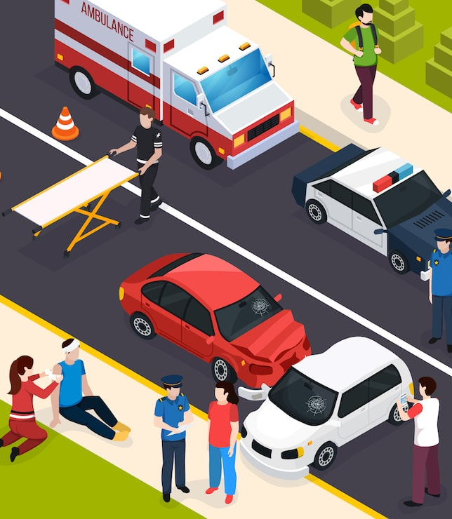
“Road Accidents” & Exploratory Data Analysis
By: Bidhismita Sahoo

Slide 2
Introduction:- The goal of this project is to analyze a large dataset of road accidents to uncover trends, patterns, and key factors contributing to accident severity. The project involves performing in-depth exploratory data analysis (EDA)using “Microsoft power BI” to extract meaningful insights that can help improve road safety.

Slide 3
Project Objectives:-
Analyze accident trends
Identify accident causes
Study weather impact
Build dashboard
Generate insights
3

Slide 4
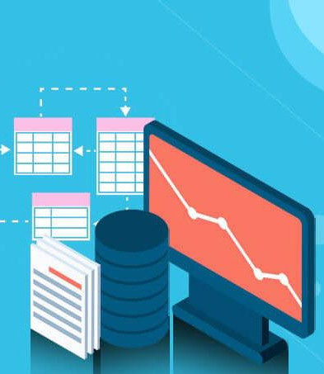
Dataset Description:- The dataset was downloaded from Kaggle. It contains road accident details such as:- Time, Location, Weather, Visibility, Severity Tools Used:- 1. Microsoft Excel 2. Microsoft Power BI

Slide 5
Project Workflow
Data Downloading
↓
Data Cleaning
↓
Data Preprocessing
↓
Data Modeling
↓
Univariate Analysis
↓
Bivariate & Multivariate Analysis
↓
DAX Calculation
↓
Geospatial Analysis
↓
Data Visualization
↓
Dashboard Data Preparation Section

Slide 6
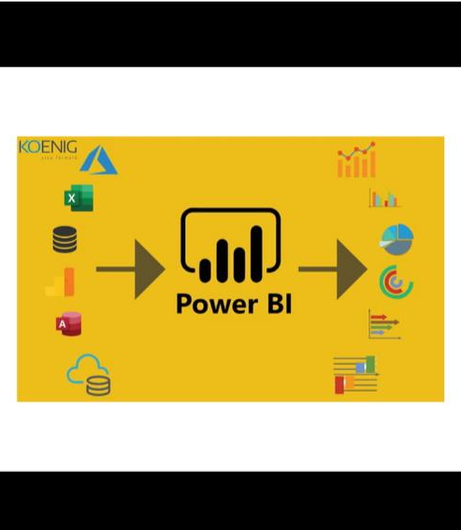
Data Preparation:- Data Downloading:- 1. Download dataset from Kaggle. Data Cleaning:- 1. Remove missing values. 2. Remove duplicate. Data Preprocessing:- 1. Create new columns. 2. Convert date & time.

Slide 7

Data Modelling:- Created relationships Organized dataset Built data model

Slide 8

Types of EDA:- Univariate Analysis Bivariate Analysis Multivariate Analysis

Slide 9
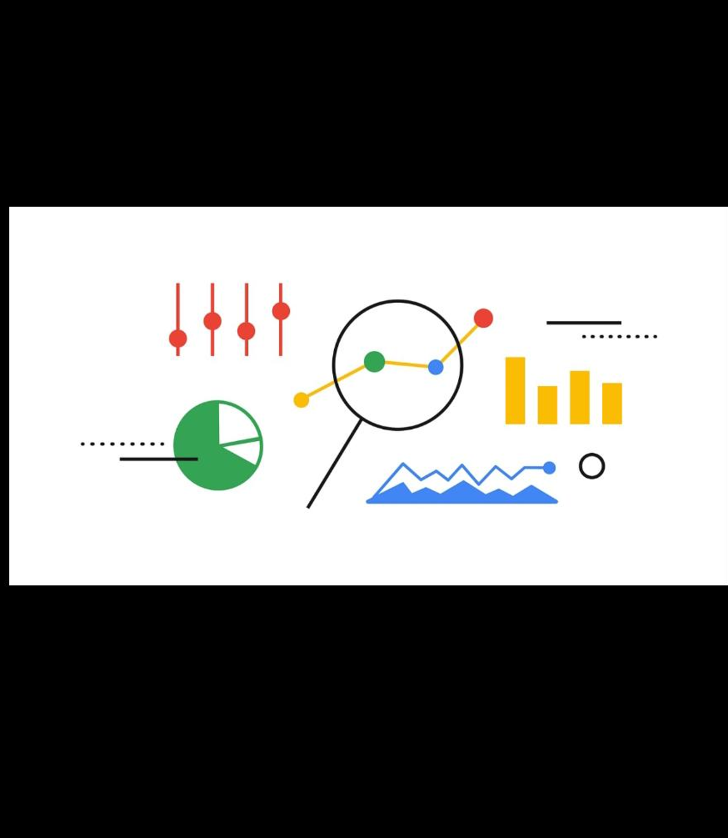
Data Analysis:- Univariate Analysis:- 1. Severity distribution 2. Weather distribution

Slide 10
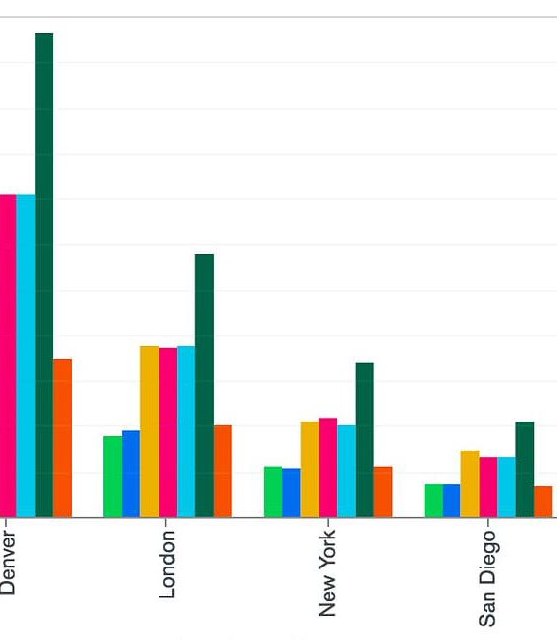
Bivariate & Multivariate Analysis:- 1. Weather vs severity 2.Visibility vs accidents DAX:- 1. Total accidents 2. Average severity

Slide 11

Geospatial Analysis:- 1. Accident hotspots 2. Location wise accidents

Slide 12
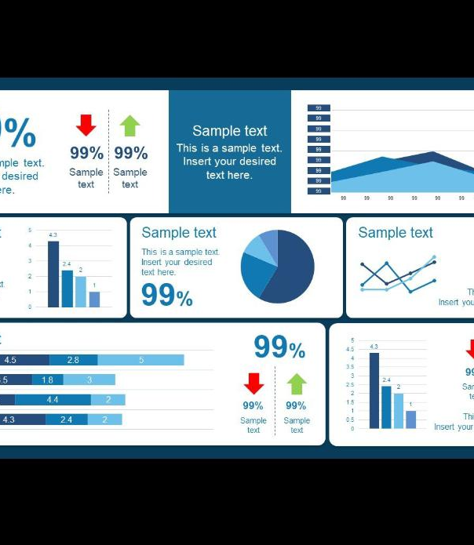
Dashboard & Insights:- Dashboard includes: 1. KPI cards 2. Charts 3. Maps 4. Slicers Key Insights: 1. Most accidents occur in evening. 2. Rain increases accidents. 3. Low visibility causes accidents.

Slide 13
Conclusion:- 1. Data analysis improves road safety. 2. Weather affects accidents. 3. Dashboard helps in decision making.

Slide 14
THANK YOU

